Slide 1

SUMMER INTERN PROJECT PRESENTATION
DEPARTMENT OF ELECTRICAL ENGINEERING
NATIONAL INSTITUTE OF TECHNOLOGY SILCHAR
ASSAM
1

Slide 2
Malware Hunter: A CNN powered malicious URL detection system
Presented By:
Anand Kumar 2013008
Mula Ganesh 2013067
Under the Guidance of:
Dr. Ripon Patgiri
Assistant Professor
Department of Computer Science and Engineering
National Institute of Technology Silchar
2

Slide 3
Introduction
Malicious URLs are one of the biggest threats to this digital world and preventing it is one of the challenging tasks in the domain of cyber security.
Previous research to tackle malicious URLs using hard-coded features have proven good indeed, but it comes with the limitation that these features are non-exhaustive and therefore detection algorithms fail to recognize new or unseen malicious URLs.
However, with the deep learning revolution, this problem can be easily solved, since deep learning models extract features of their own by learning from patterns occurring in such URLs.
3

Slide 4
Literature Survey:
Research Article | authors | Research Findings
1. Deep Approaches on Malicious URL Classification | Arijit Das , Ankita Das , Anisha Datta, Shukrity Si and Subhas Barman | The CNN LSTM hybrid model is trained for 120 epochs using preprocessed URLs and their corresponding class labels. The model is validated on a test set of 58,440 URLs. The CNN LSTM model achieves an accuracy of 93.59%.
2. Malicious URL Detection using Deep Learning | R, vinayakumar; S, Sriram; KP, Soman; Alazab, Mamoun | Objective is to classify whether the URL is either benign or malicious. Character-level embedding methods were used for text representation. Most of the models performed well on Data set 1 in comparison to Data set 2 random split and Data set 2 time split.
4

Slide 5
OBJECTIVES:
To develop a CNN model for malicious URLs classification that is accurate and efficient.
To evaluate the performance of the proposed model on a real-world dataset.
To identify the limitations of the proposed model and suggest directions for future work.
5

Slide 6
Methodology:
Collect a dataset of malicious and benign URLs.
Preprocess the data by tokenizing the URLs by characters and padding them to a fixed length.
Train a CNN model on the training data using the Adam optimizer and the sparse categorical crossentropy loss function.
Evaluate the model on the testing data.
6

Slide 7
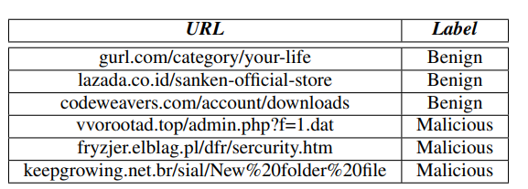
Dataset:
The dataset is loaded from a CSV file containing two columns: 'url' and 'label'.
'url' column contains the URLs to be classified.
'label' column contains the corresponding labels ('phishing' , 'benign', 'defacement' and 'malware').
The URLs were collected from a variety of sources, including public blacklists, phishing websites, and legitimate websites.
Fig1: Sample dataset
7

Slide 8
Data preprocessing:
Label Conversion: We converted the labels to numerical format so that the model could better understand them.
Benign as 0
Defacement as 1
Phishing as 2
Malware as 3
Data Splitting: We then split the dataset into training and testing sets to prevent overfitting and to assess the model’s performance effectively.
Train data contains 80% of dataset
Test data contains 20% of dataset
8

Slide 9
Continuation:
Tokenize The URLs: The URLs are tokenized by characters using the Tokenizer from Keras.
"https://leetcode.com/problems/single-element-in-a-sorted-array/description/"
Tokenized URL: ['h', 't', 't', 'p', 's', ':', '/', '/', 'l', 'e', 'e', 't', 'c', 'o', 'd', 'e', '.', 'c', 'o', 'm', '/', 'p', 'r', 'o', 'b', 'l', 'e', 'm', 's', '/', 's', 'i', 'n', 'g', 'l', 'e', '-’, ……]
Sequence Padding: The sequences are padded to a fixed length (maxlen=100) to ensure uniform input shape for the CNN model.
9

Slide 10
Model Architecture:
The model consists of an Embedding layer, followed by a 1D Convolutional layer, Global Max Pooling, and Dense layers.
The Embedding layer: It learns the representation of each character in the URL.
The Conv1D layer: It performs convolutions over the character embeddings to capture local patterns.
Global Max Pooling layer: It extracts the most important features from the convolutional layer.
Dense layers: This layer with ReLU activation and Dropout are used for classification.
Dropout Layer: This layer randomly drops 50% of the neurons during training. This helps prevent overfitting by reducing the reliance on specific neurons.
10

Slide 11

Embedding layer
Letter h is embedded as [0.123, 0.456, 0.789, ...] and every letter represented as 1D vector.
Conv1D
[[0.1, 0.2, 0.3], [0.4, 0.5, 0.6], [0.7, 0.8, 0.9]](filter) convolutes with character embeddings to
[[Feature map 1] [Feature map 2] [Feature map 3]]
Global Max Poling
The global max pooling layer reduces the dimensionality of the data, while still preserving the most important features.
[0.876, 0.923, 0.754, ...]
Dense Layer
Dropout Layer
Output
11

Slide 12
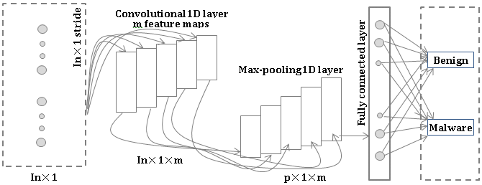
Model Training:
The model was trained on the training data using the Adam optimizer and the sparse categorical cross-entropy loss function.
The model was trained for 10 epochs.
Model Testing:
The model was evaluated on the testing data.
The model achieved an accuracy of 98% on the testing data.
Fig2: Model Architecture
12

Slide 13
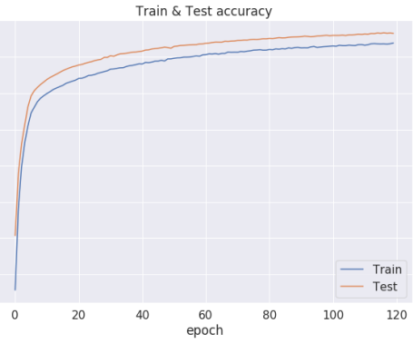
results:
0.95
0.90
0.85
0.80
0.75
0.70
0.65
Fig3: Train & Test accuracy graph
13

Slide 14
conclusion:
The CNN model is effective for malicious URL detection. The model achieved a high accuracy on the testing dataset, demonstrating its ability to generalize to new data. The model is also relatively simple and can be easily implemented, making it a suitable model for use in real-world applications.
15

Slide 15
T
H
A
N
K
Y
O
U

